Slide 1
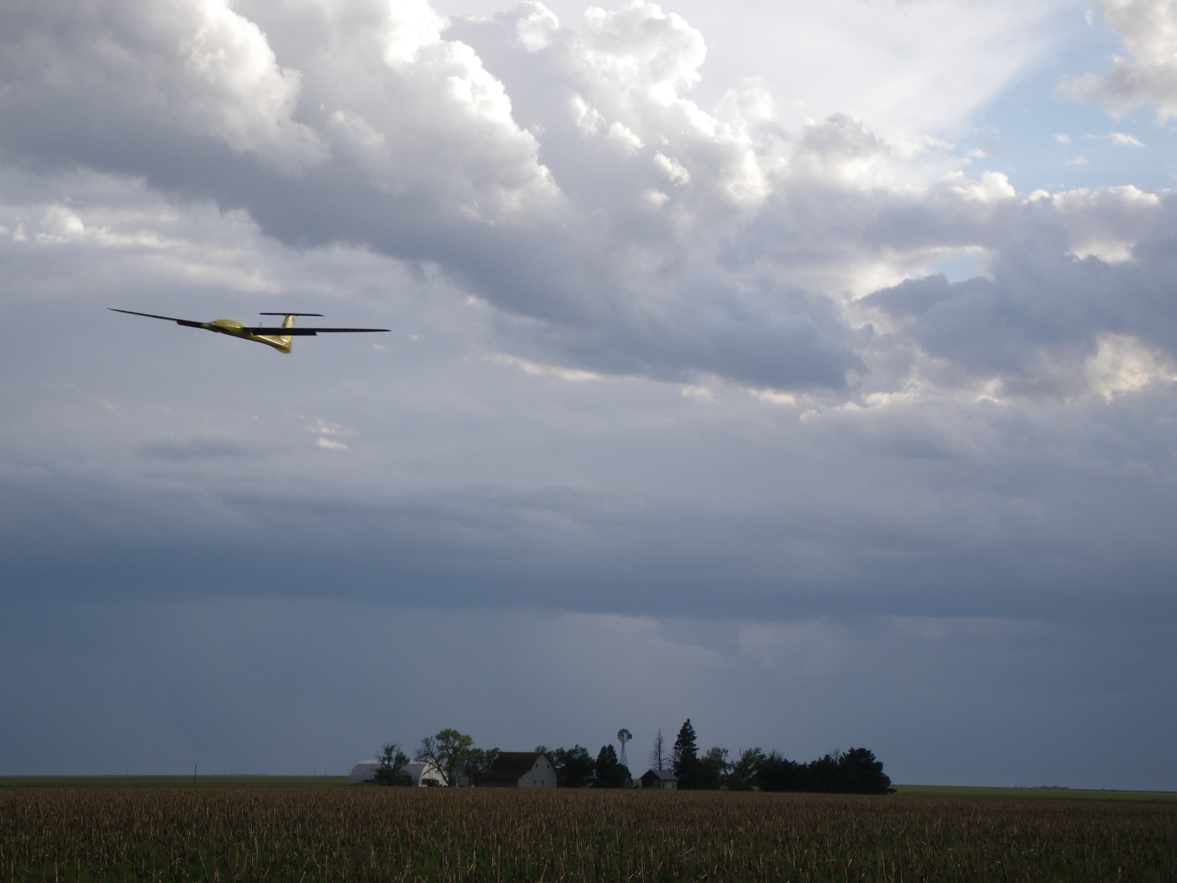
Chapter 1
Introduction

Slide 2
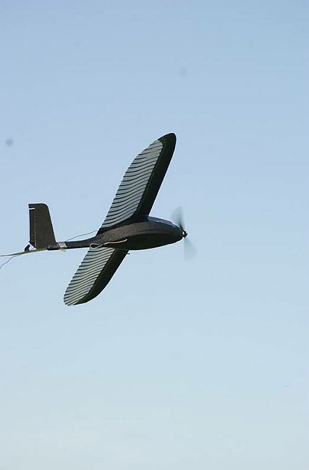
Potential Applications for Small UAVs
Civil and Commercial:
Monitoring environment − meteorology, pollution, mapping, mineral exploration
Monitoring disaster areas − forest fires, avalanches, nuclear contamination
Communications relays − news broadcasts, disaster relief, sports events
Law enforcement − road traffic, border patrol, drug control
Precision agriculture − crop monitoring
Military:
Special Operations: Situational awareness
Intelligence, surveillance, and reconnaissance
Communication node
Battle damage assessment
Homeland Security:
Border patrol
Surveillance
Rural/urban search and rescue
New related area:
Air mobility of humans, goods, services

Slide 3
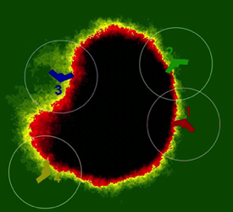
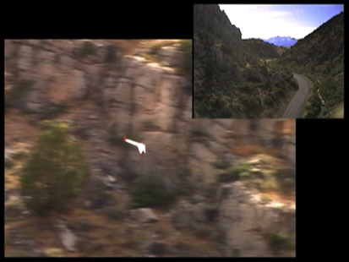
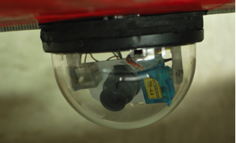
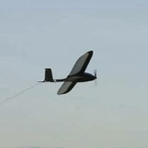
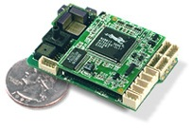
UAS Research at BYU
Cooperative timing problems
Cooperative persistent imaging
Cooperative fire monitoring
Consensus seeking
3D Waypoint path planning
Wind compensation
Collision avoidance
Optic flow sensor
Laser ranger
EO cameras
Image stabilization
Geo-location
Vision-aided tracking & engagement
Autopilot design for small UAVs
Attitude estimation
Adaptive control
Tailsitter guidance & control
Cooperative Control
Path Planning Trajectory Generation
Vision-based Control
Autonomous Vehicles

Slide 4
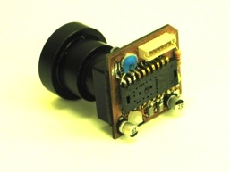
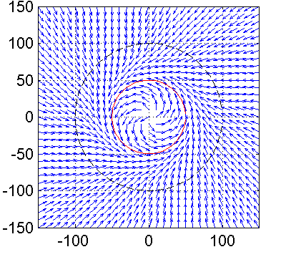
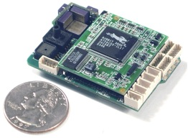



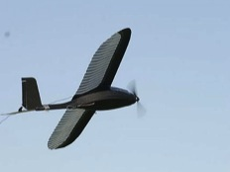
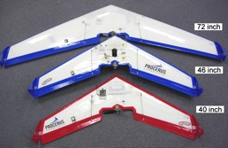
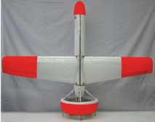
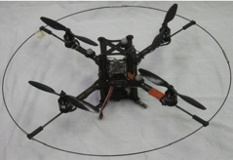
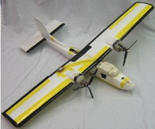
Autonomous Flight for sUAS with SWaP Constraints
Sensor-based Flight
Optic flow
Laser range finder
EO/IR
Applications
Canyon following
Collision avoidance
GPS-denied navigation
Path Following
Robust to wind
Computationally efficient
Applications
Precision navigation
Target tracking
Target geo-location
Kestrel Autopilot
Auto take-off, land
Waypoint NAV
GPS guided
Technology Transition
2004
2012

Slide 5

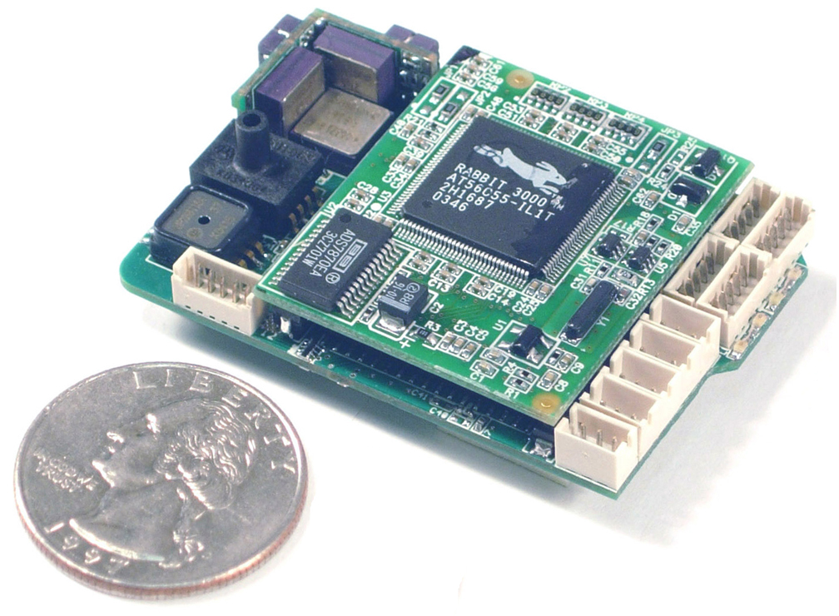

Kestrel Autopilot v2.2
3-Axis Angular Rate & Acceleration Measurement
20 Point Sensor Temperature Compensation
Kalman Filter Attitude Estimation
Optional “piggy-back” Modem
Configurable Failsafes
2-Axis Magnetometer
2-Axis Gimbal Support
Dead reckoning filter
gracefully handles GPS outages
Multiple-UAVs
Smart Loiters
Auto-Trim
16.7 grams
2” x 1.37” x .47”
Notes:
60 seconds

Slide 6
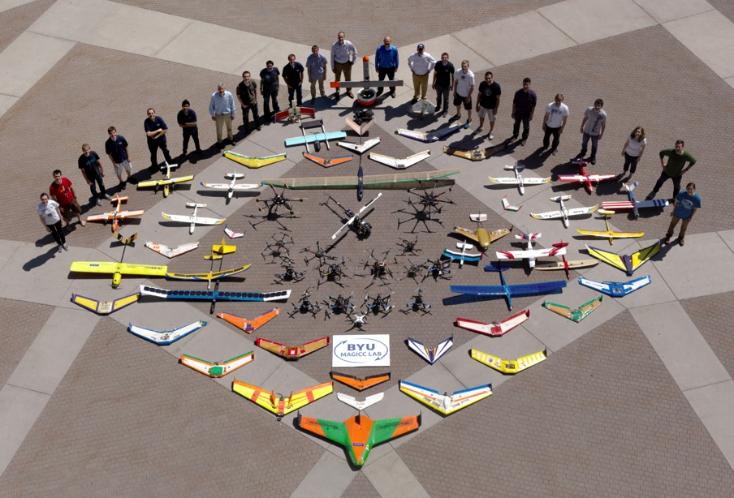
Over 20 years of
UAS research at BYU

Slide 7


























The National Science Foundation
Center for Unmanned Aircraft Systems
Industry Members
National UAS
Training and Certification Center
Notes:
Government agencies and research labs
Established aerospace contractors
New UAV focused aerospace companies
Application focused companies and end users
Training and certification

Slide 8
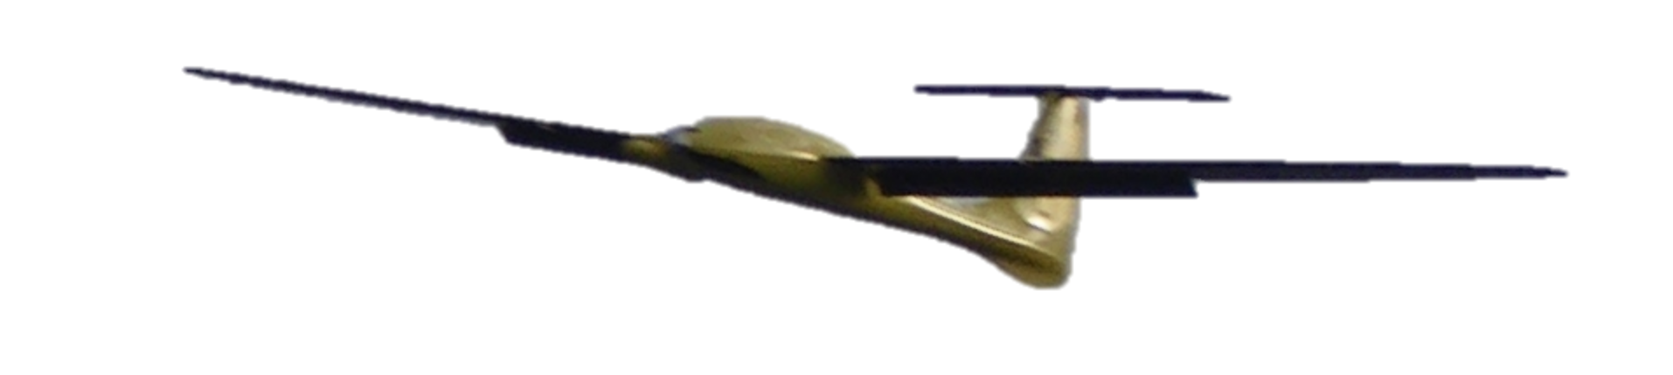
Control Design Process
Physical System
The real thing
1st principles
Detailed model
ODE’s, nonlinear, high order
Includes everything that is feasible to model
Hi-fi representation of real physical system behavior
Too complex for control design
Simulation
Model
ODE’s, linear, low order
May only consider a portion of dynamic behavior
Simpler to understand
Captures dominant behavior
Design
Model
Control
Design

Slide 9
Simulation Model

Slide 10
Simulation Model

Slide 11
Control Design Process
Physical System
The real thing
Detailed model
ODE’s, nonlinear, high order
Includes everything that is feasible to model
Hi-fi representation of real physical system behavior
Too complex for control design
Simulation
Model
ODE’s, linear, low order
May only consider a portion of dynamic behavior
Simpler to understand
Captures dominant behavior
Design
Model
Control
Design

Slide 12
Design Model
Course from aileron transfer function:

Slide 13

Control Design
Design model

Slide 14
Control Design Process
Physical System
The real thing
Detailed model
ODE’s, nonlinear, high order
Includes everything that is feasible to model
Hi-fi representation of real physical system behavior
Too complex for control design
Simulation
Model
ODE’s, linear, low order
May only consider a portion of dynamic behavior
Simpler to understand
Captures dominant behavior
Design
Model
Control
Design

Slide 15
Control Design Process
Design
Model
Step 1:
Linear, low-order model
Control design and system model implemented in software
Control
Design

Slide 16
Control Design Process
Simulation
Model
Step 2:
Detailed system model
Control design and system model implemented in software
Control
Design

Slide 17
Control Design Process
Physical System
hardware
Step 3:
Real system hardware
Control design implemented in software
Control
Design
software

Slide 18
Architecture

Slide 19
Architecture w/ Camera

Slide 20
Course Project Ideas
Implement autopilot components on hardware using ROSflight, PixHawk, or another autopilot
Develop learning modules for the African Drone and Data Academy in Malawi (e.g., Jupyter notebooks)
Integrate our course simulator into the AirSim simulator (https://github.com/microsoft/AirSim)
Extend existing autopilot components to do something in a different way (e.g., perform path following using MPC)
Extend existing autopilot to do something new (e.g., use machine vision to land on a target)
Something of your own creation that builds on the concepts of this course

